Slide 1

PREDICTION OF GASTROINTESTINAL DISEASES FROM ENDOSCOPIC IMAGES USING ML ALGORITHMS
Leenus Valantine A
URK21CS2019
Karunya Institute of Technology and Science,
Coimbatore
Guide - Dr. D. Brindha

Slide 2
Introduction
1. Gastrointestinal disorders, such as ulcer and colonic polyps, are widespread globally and can lead to serious health complications if not treated promptly.
2. It is essential to accurately diagnose gastrointestinal disorders for timely intervention and effective management, ultimately leading to improved patient outcomes and overall quality of life.
3. Endoscopy is a crucial diagnostic tool that allows healthcare professionals to directly visualize the gastrointestinal tract, identify abnormalities, and obtain tissue samples for further evaluation.

Slide 3
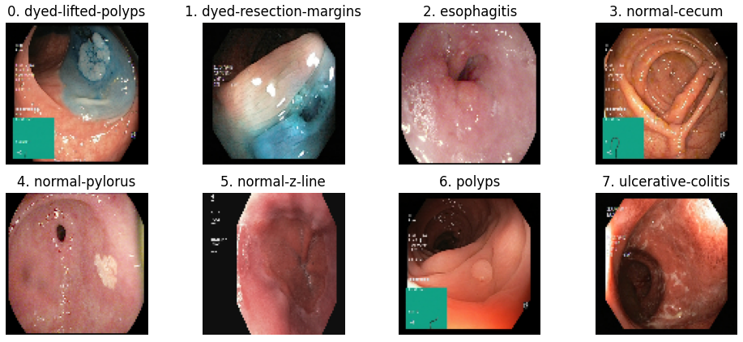
Objective
1. Gastrointestinal disorders, such as gastric ulcers and colonic polyps, are widespread globally and can lead to serious health complications if not treated promptly.
2. It is essential to accurately diagnose gastrointestinal disorders for timely intervention and effective management, ultimately leading to improved patient outcomes and overall quality of life.
3. Endoscopy is a crucial diagnostic tool that allows healthcare professionals to directly visualize the gastrointestinal tract, identify abnormalities, and obtain tissue samples for further evaluation.

Slide 4
Motivation
Purpose:
Since the endoscopic tract plays an important role in digestion, utmost care needs to be taken since it is crucial for a healthy life. Our primary motivation is to enhance early diagnosis of gastrointestinal diseases, ultimately improving patient outcomes and quality of life.
Patient Impact:
Since it can be affected by various life-threatening diseases, sometimes it might be too late to detect. By detecting diseases at an early stage, we aim to reduce patient suffering and healthcare costs while improving overall management of gastrointestinal disorders.
Research Significance:
Modern technology has benefited in the treatment of these anomalies, and with the development of computer-assisted therapy, we may now identify such anomalies early.
Community Benefits:
Each year, approximately 2.8 million cases of GI-tract related diseases are registered resulting in mortality rates as high as 15% in previously inaccessible parts of the body. The societal impact of our research is significant, as it offers a pathway to better healthcare and management of gastrointestinal illnesses.

Slide 5
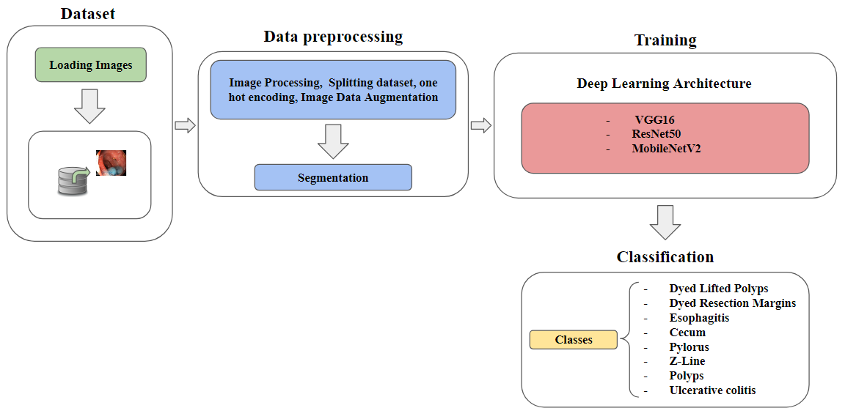
Proposed System Architecture
1. Firstly, we preprocess the data, resize, normalize, equalize, and data enrichment.
2. Secondly, we classify the dataset based on the output of the previous step, although it comes with 8 categories preprocessing helps to reduce runtime and improve accuracy.
3. Thirdly, we divided the process in two steps, we use the most optimal architecture by altering parameters then we use different deep learning approach for better accuracy.
4. Finally, we created pre-trained models such as VGG16, ResNet50, MobileNetV2 and Monitored the training process including validation accuracy.

Slide 6
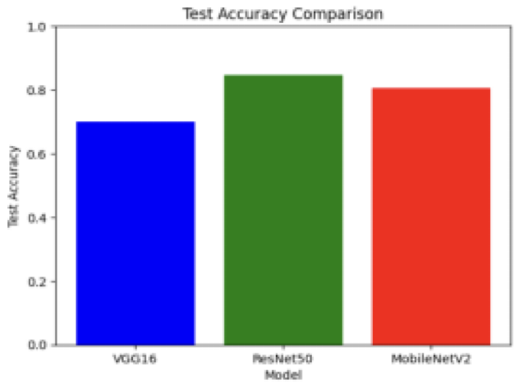
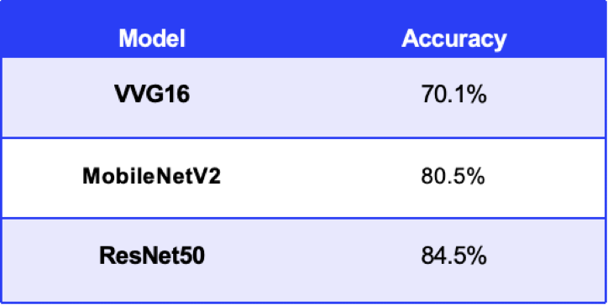
CompARISON ANALYSIS
Comparative analysis of VGG16, ResNet50, and MobileNetV2 models revealed ResNet50 as the top performer with 84.5% accuracy.

Slide 7
Conclusion and Future Work
1. Preprocessing steps, including data augmentation and normalization, contributed to improving model performance and robustness.
2. The project demonstrates the potential of deep learning models in aiding medical diagnosis, particularly in gastroenterology.
3. Further refinement of the models by exploring additional architectures and hyperparameters could potentially enhance performance.
4. Integration of advanced techniques such as transfer learning or ensemble methods may lead to improved accuracy and generalization.
5. Expansion of the dataset and inclusion of diverse gastrointestinal images could make the model more versatile and applicable to a wider range of conditions. Additionally, gathering longitudinal data for patient-specific analysis could provide valuable insights into disease progression and treatment response.

Slide 8
Thank You

